Slide 1
Binary Numbers

Slide 2
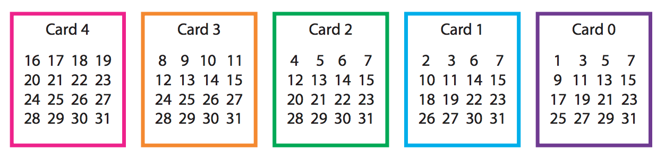
Card Trick
Think of a number between 0 and 32.
I will ask you to find the number on each of the five cards. Tell me “yes” or “no” when I ask you if the number is found on the card.
I will tell you your number quickly.

Slide 3
How does the trick work?
The secret is in the binary number system.
https://www.youtube.com/watch?v=UYa5xBFn7jE

Slide 4
Representation
The number “1” represents the ________ electric signal.
The number “0” represents the ________ electric signal.

Slide 5
The place values for the first four places in a binary number are
8 4 2 1

Slide 6
What are the following binary numbers?
0000 _________ 0101 ________ 1010 _________
0001 _________ 0110 ________ 1011 _________
0010 _________ 0111 ________ 1100 _________
0011 _________ 1000 ________ 1101 _________
0100 _________ 1001 ________ 1111 _________

Slide 7
What are the following binary numbers?
0000 0 0101 5 1010 10
0001 1 0110 6 1011 11
0010 2 0111 7 1100 12
0011 3 1000 8 1101 13
0100 4 1001 9 1110 14 1111 15

Slide 8
What is the largest number you can make with a 4-bit number? ____________________
What is the largest number you can make with an 8-bit number? ____________________

Slide 9
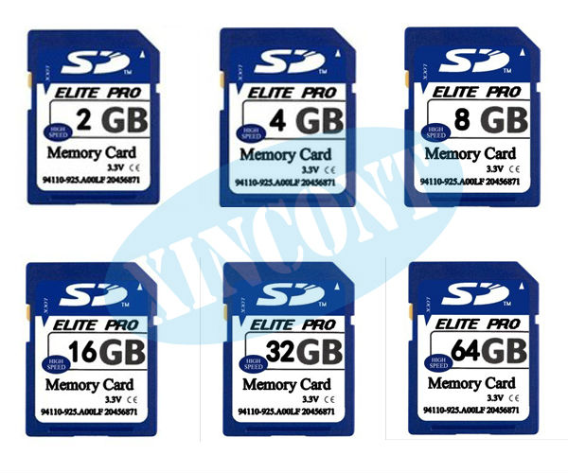
You will notice binary counting in memory, CPU speeds and disk drives.

Slide 10
What are these binary numbers?
10010 __________
10101 _________
11010 __________
10001 __________
00010 _________
11011 __________

Slide 11
What are these binary numbers?
10010 18
10101 23
11010 26
10001 17
00010 2
11011 27

Slide 12
Write these decimal numbers in binary
6 _________ 15 _________ 31 __________
7 _________ 16 _________ 32 __________

Slide 13
Write these decimal numbers in binary
6 0110
15 1000
31 011111
7 0111
16 10000
32 100000

Slide 14
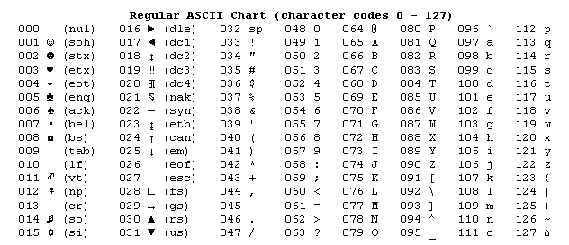
The ASCII table for 0-127 (American Standard Code for Information Interchange)

Slide 15
